Slide 1
SOFTWARE ENGINEERING
FINAL PROJECT: LOTTERY MACHINE

Slide 2
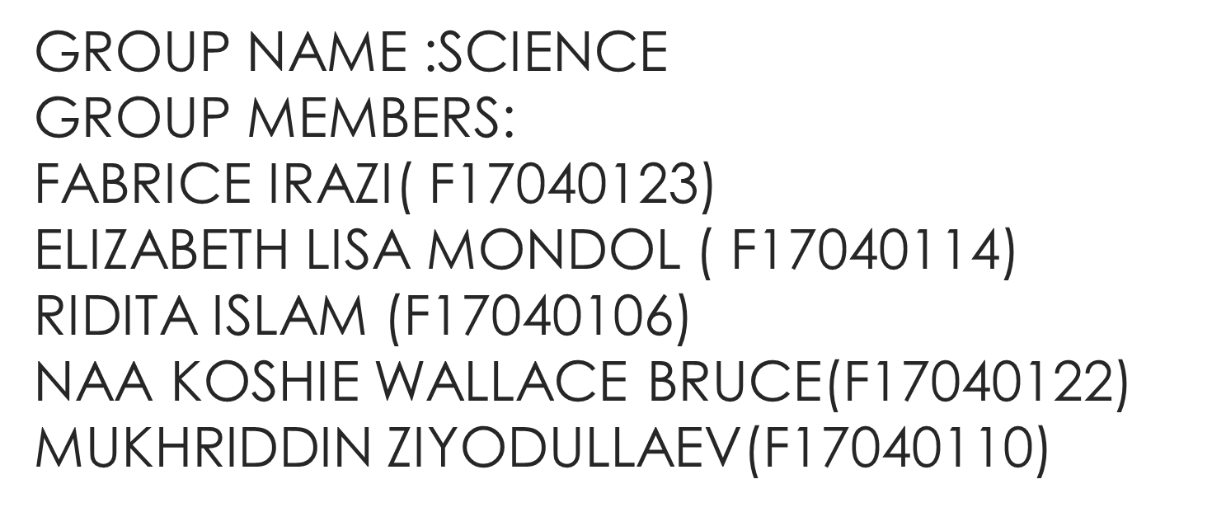

Slide 3
INTRODUCTION
A lottery is a game of chance in which people pay for the opportunity to win prizes . Part of the money taken in by a lottery is used to award the winners and to pay the costs of administering the lottery. The money left over is profit. Lotteries are extremely popular and legal in more than a hundred countries.
Our goal is to make a software lottery machine which is very faithful and reliable.
The players just need to get a number by scanning the QR code through we chat .The players can take part of the lottery by scanning the QR code.

Slide 4
HOW TO INTERACT WITH THE SYSTEM
The user has just to get a QR code to scan. After scanning he’ll get an information about the lottery. He’ll have to provide his name and an id will be provided for him for a particular identification.  The admin is one who is in charge for running the software. He will register the name for the user in a database. He is going to use java editor to store information and also he’s the one to provide an id and also some information to the user about how and when the lottery is happening.  The user and admin are using Wechat to communicate about anything as the user is providing his information.

Slide 5
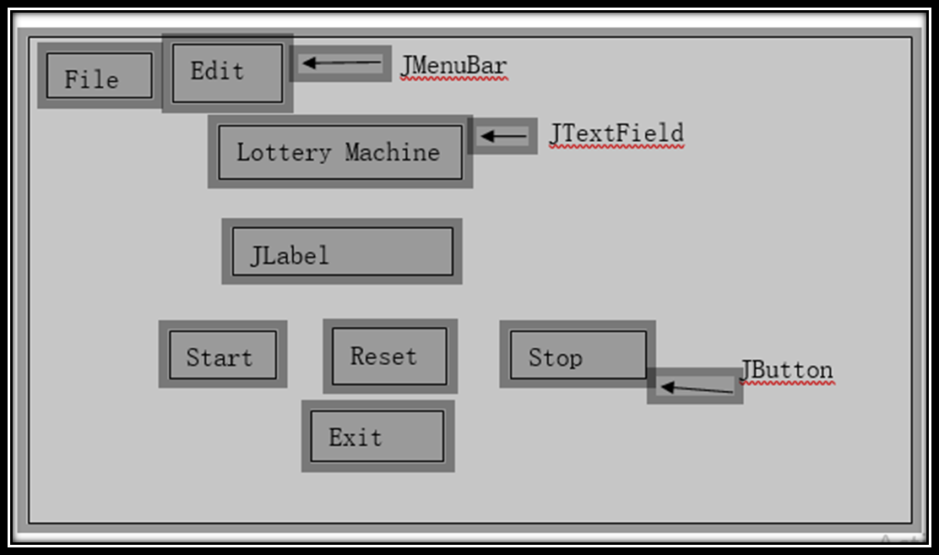
OUR DEMO WAS:

Slide 6
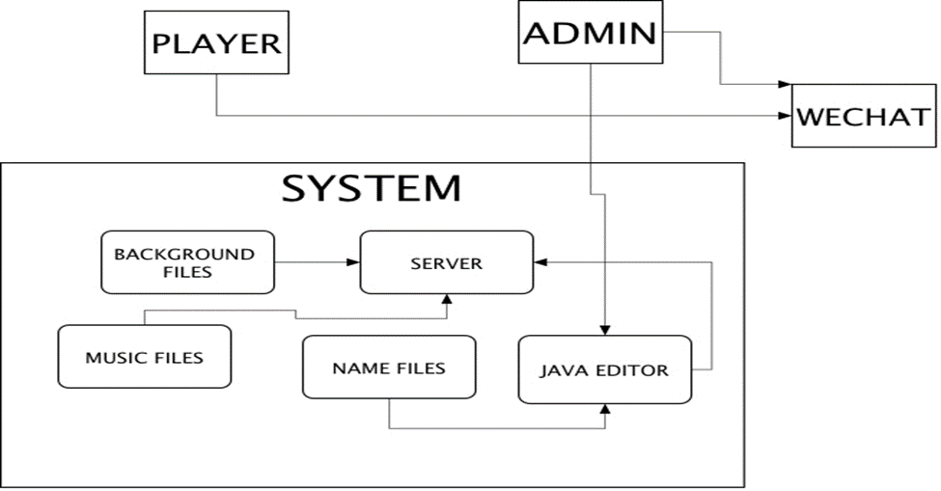
SYSTEM ARCHITECTURE

Slide 7
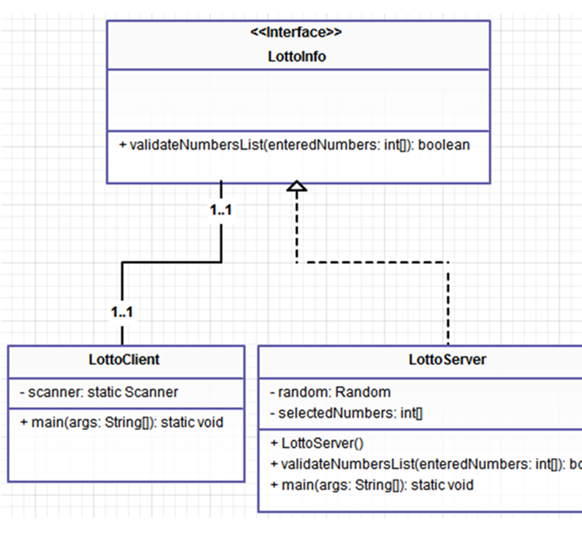
CLASS DIAGRAM

Slide 8
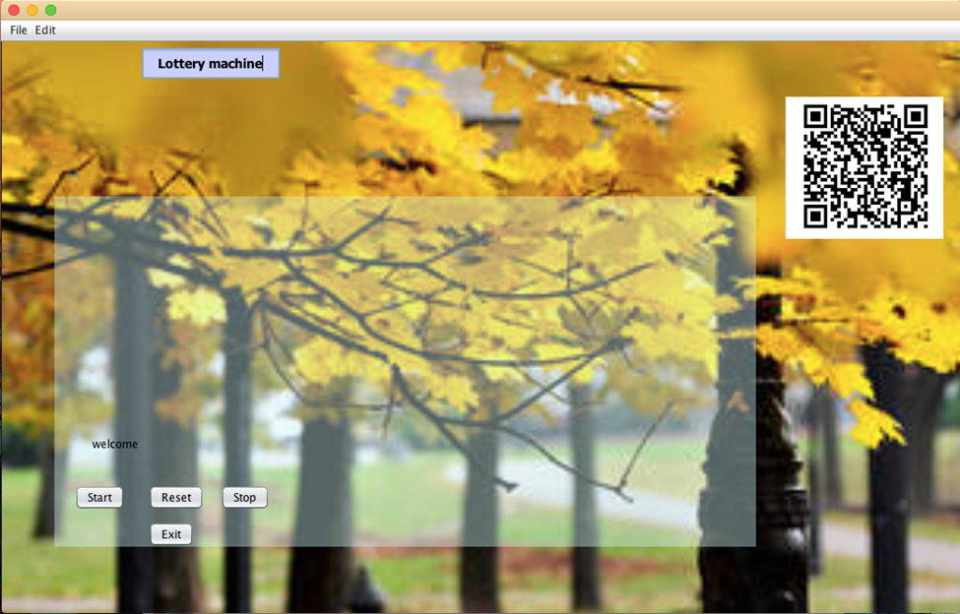
OUR FEATURE

Slide 9
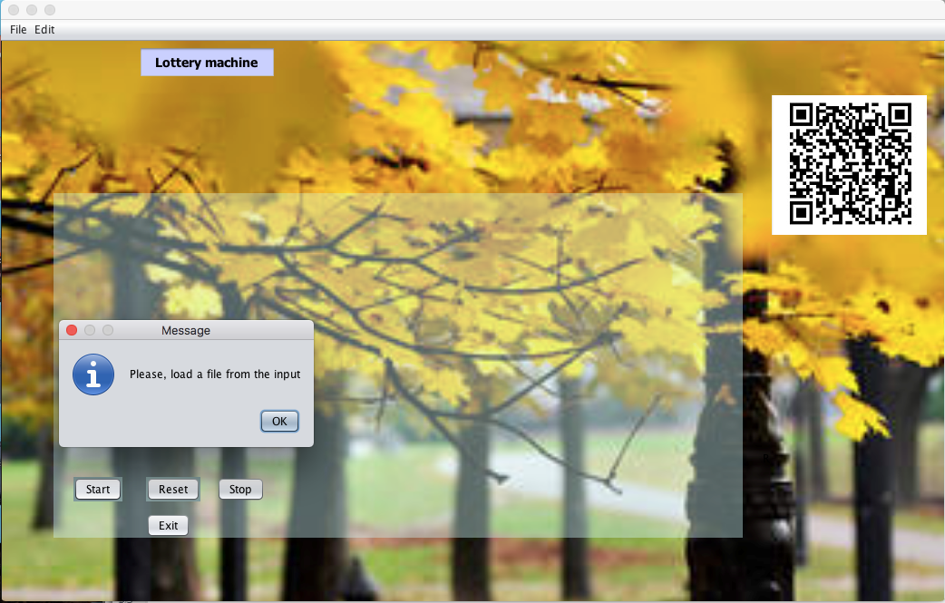
MODULES

Slide 10
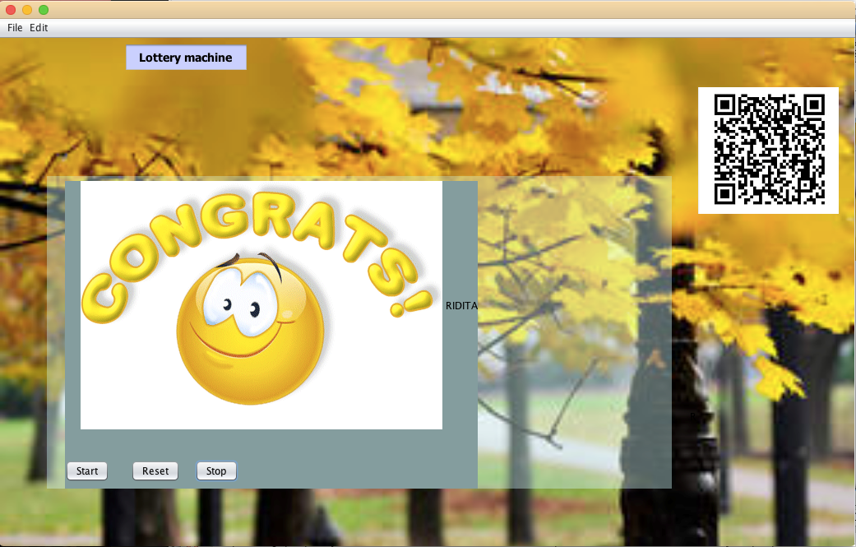
THE FINAL OUTPUT

Slide 11
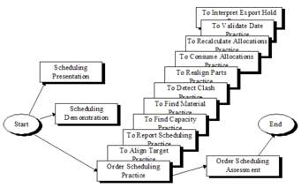
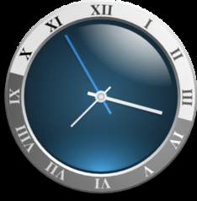
TEAM PLAN AND SCHEDULE

Slide 12

MATERIALS

Slide 13
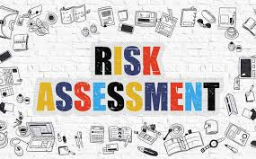

RISK ASSESSMENT

Slide 14
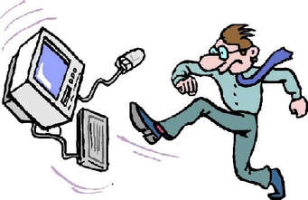
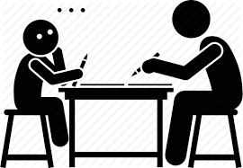
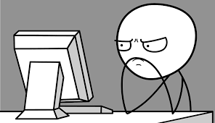
DIFFICULTIES

Slide 15
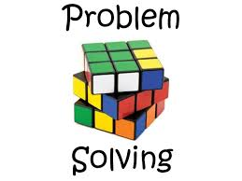
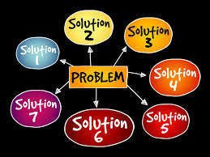
PROBLEM SOLVING

Slide 16
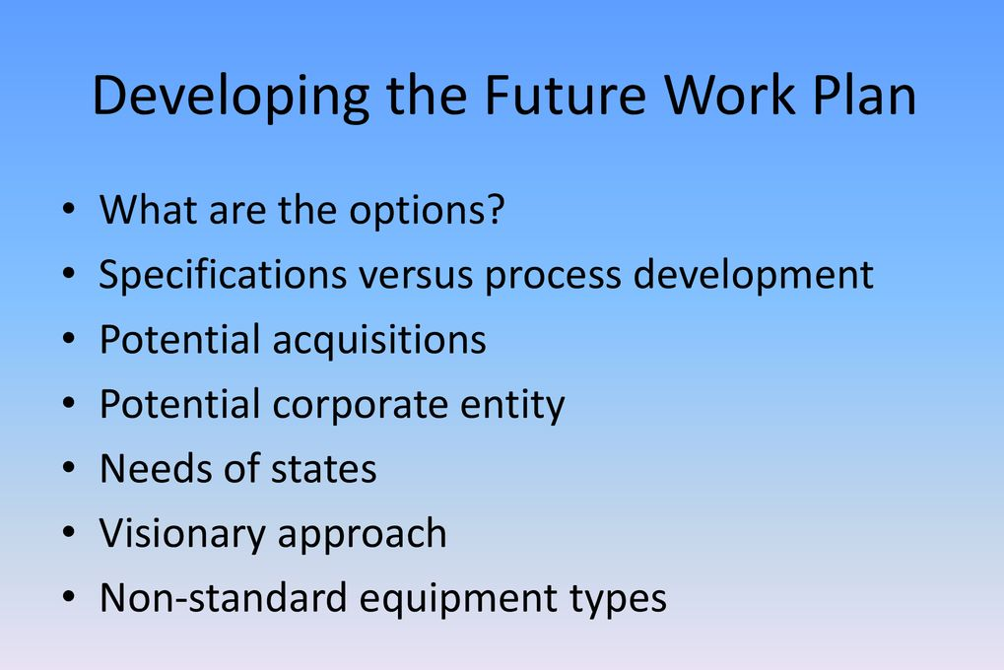

Slide 17
CONCLUSION
The topic we chose was quite challenging. Sometimes we had many ideas but to execute we had to work on it so hard. We were not so good at java so the project helped us a lot to learn new things in java because we had to do a lot of researches. During our coding part we were facing some errors, from which we worked on different ideas to build the software successfully. There were some lacking on our project so our respected Laoshi gave us some good ideas and suggestions to make it look more interesting. After putting so much effort and using our good team work, we successfully built our desired project.

